Slide 1

FYP-I Mid Evaluation
Team
19F-0113 Talha Ahmad
19F-0171 M. Talha Shehroze
19F-0254 Muhammad Farhan
Supervisor
Mr. Rizwan ul Haq

Slide 2
Team/Company Name:
What’s Trending
Supervisor(s):
Mr. Rizwan ul Haq
Co-Supervisor(s):
Mr. Sajid Anwer
Project Name/Title:
What’s trending (A Twitter Analysis Site)
What’s Trending?

Slide 3
Project introduction
Web-based application
Bot/fake Account Identification
Fake trend Recognition
Trending keywords Analysis
Twitter Account analysis
Developer API
Facilitate the user in making a better decision

Slide 4
Modules
Developer API
System will provide a portal to developer where they provide query to system and system show result in JSON format.
Bot Account recognition
Identify whether the participating account was operated by a fake, bot, or authentic account.
What’s Trending?

Slide 5
Modules
Account Analysis
Statistical analysis will predict the trend timeline, growth rate, growth region, activity graph, popular tweet, and popular retweet of requested user.
Visualization
The system will generated visualized data in order to make it easy for user to understand the predictions and analysis

Slide 6
Modules
Trend quality
Prediction of trend quality based on factors i.e., unique account participation, unique message, analyzing trend starter accounts, checking bot accounts participation, and some other factors by using AI, and ML techniques.
Trend Analysis
Statistical analysis will predict the trend timeline, growth rate, growth region, activity graph, popular tweet, and popular retweet of requested trend.

Slide 7
Use Case Diagram

Slide 8
Component Diagram

Slide 9
Data Flow Diagram

Slide 10
Package Diagram

Slide 11
State Machine Diagram

Slide 12
Swim Lane Diagram UI

Slide 13
Swim Lane Diagram API

Slide 14
SSD Sign-up User

Slide 15
SSD Sign-In User

Slide 16
SSD Analyze Trend

Slide 17
SSD Extract Trend Quality

Slide 18
SSD Recognize Bot Account

Slide 19
SSD Analyze Account

Slide 20
SSD Developer API

Slide 21
SD User Interface

Slide 22
SD API

Slide 23
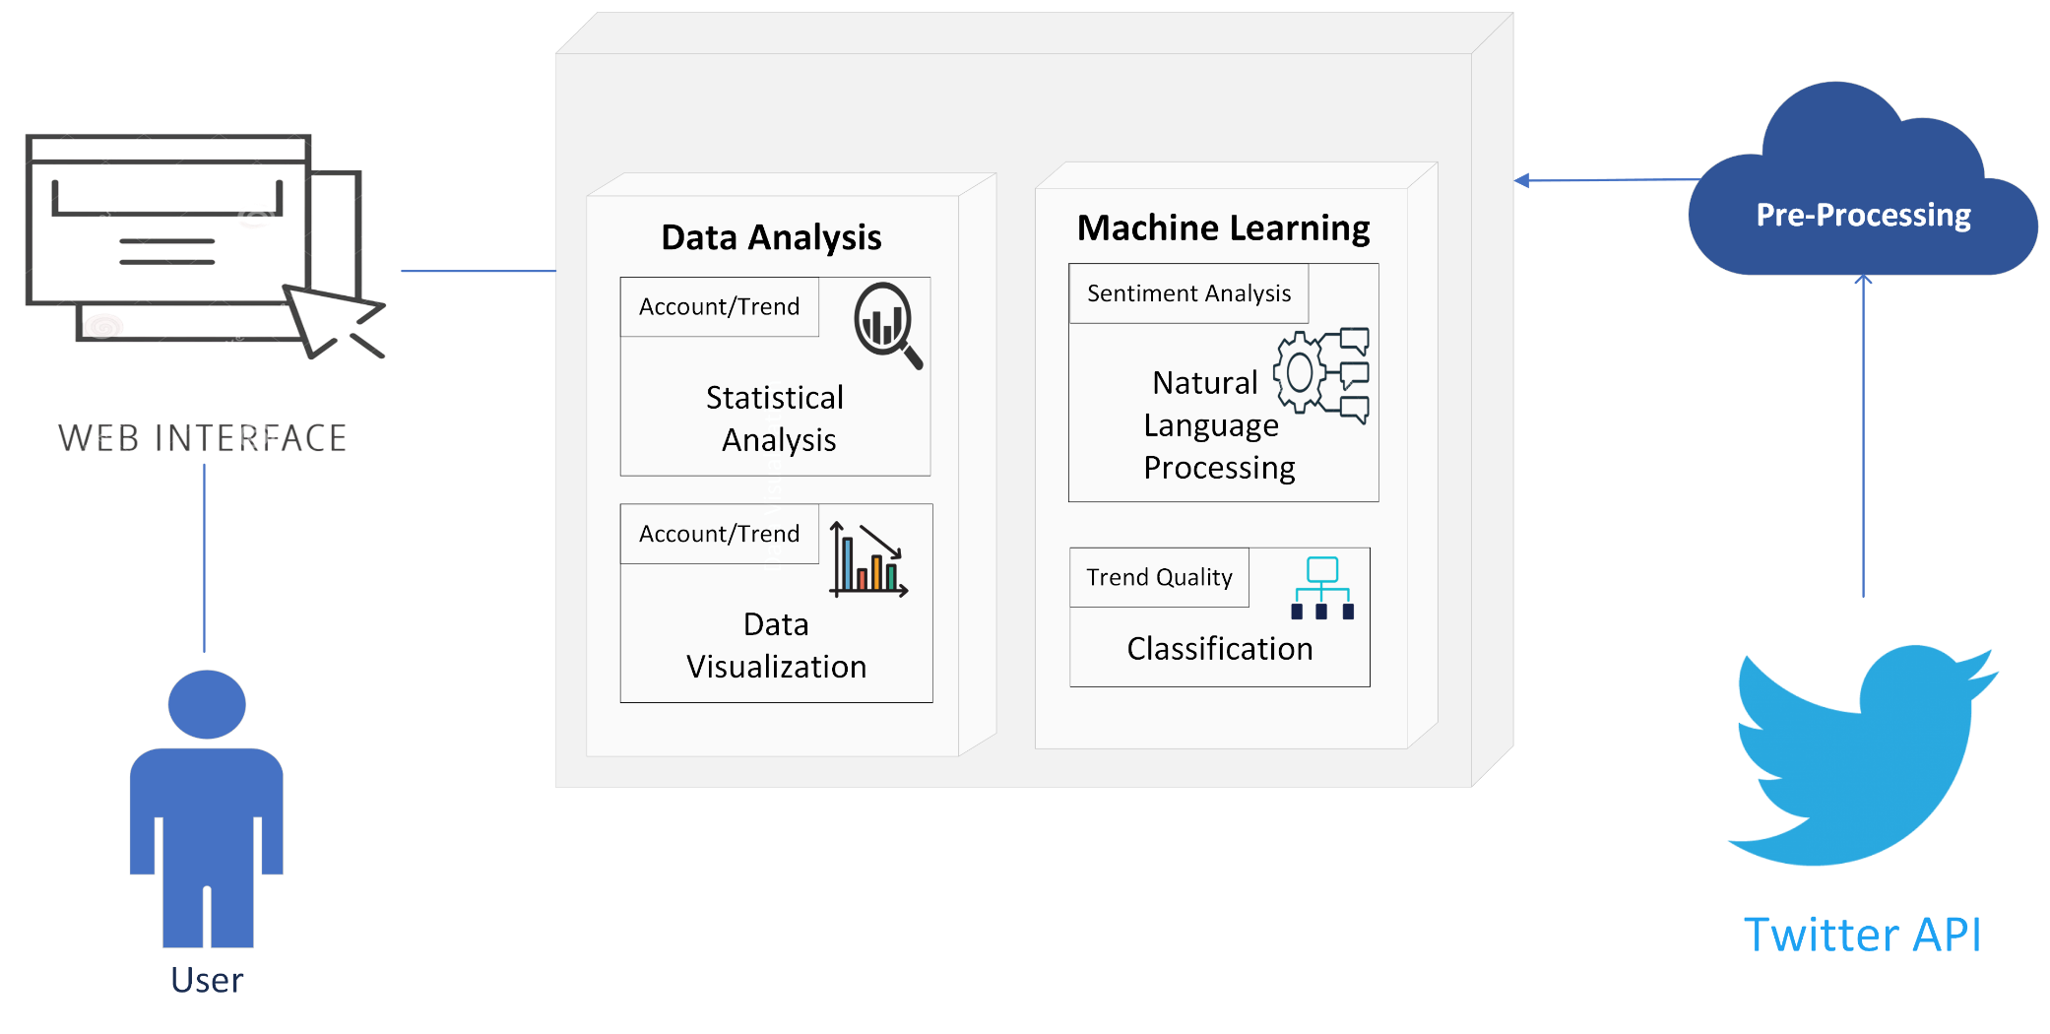
Architecture Diagram

Slide 24
Commitment
User Interface
Account Analysis
Bot Account Recognition

Slide 25
Commitment
User Interface | Account Analysis | Bot Account Recognition
Template Hunt | Scrape User Profile | Training Data Collection
Configuring interface | Chart showing at which time user tweet | Training Feature Extraction
Update Interface According to Requirement | Graph showing his frequency of tweet in day | Training Feature Selection
Account Analysis with Interface | Graph showing his frequency of tweet in last 4 weeks | Regression Model
 | Statistic | Optimize Model (Need Complex model)

